Slide 1
B R JACKETS

Slide 2
Innov Composite Armor ( ICA ) is in process of establishing state of art facility to manufacturing of Body Armour ( ballistic and stab protection) , Composites /Hybrid Matrix Panels for Vehicle / Architectural applications. We have dedicated team of experts in Ballistic Protection field over a decades of experience in Design and Manufacturing field , they knew unique composite properties to meet technical challenges in ballistic materials processing & testing techniques. We are in a process of building up a strong international image as a company which provides and invents in modular & customized and integrated ballistic systems. We use a wide variety of ballistic materials including aramides, polyethylenes, glass fibers, ceramics, steel and hybrids. We have unique test arrangements with International /National ballistic laboratory which allows us to perform all kinds of tests and examinations of the our materials, and to keep a eye on quality control norms on our productions.
We manufacture a complete range of B R Jackets for covert, overt, law enforcement, naval and military usage. The ergonomic shapes are combined with low weights and increased protection areas. All our models are fully customizable and could be upgraded with additional peripheral and hard armor protection. Using only top quality fabrics and materials we can provide warranty of our products as committed by raw materials vendors . Our products are tested and meet even the most sophisticated customer requirements.

Slide 3
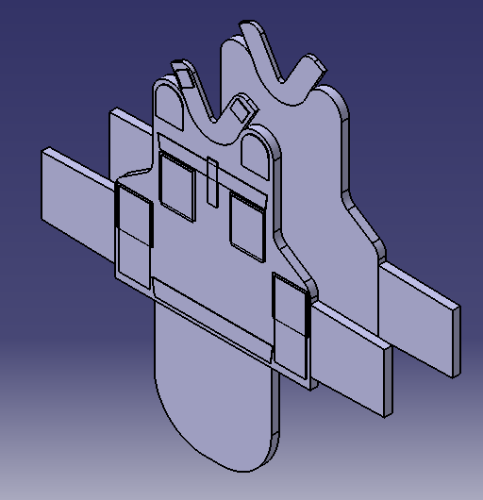
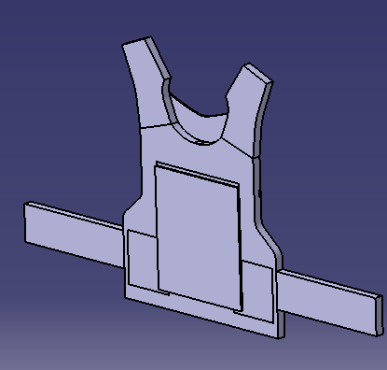
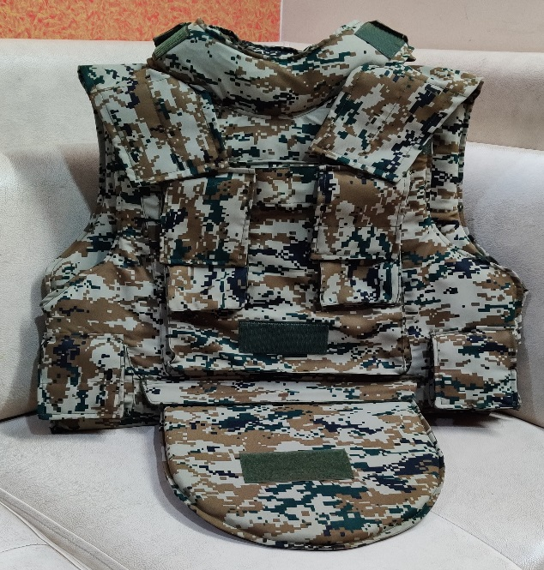
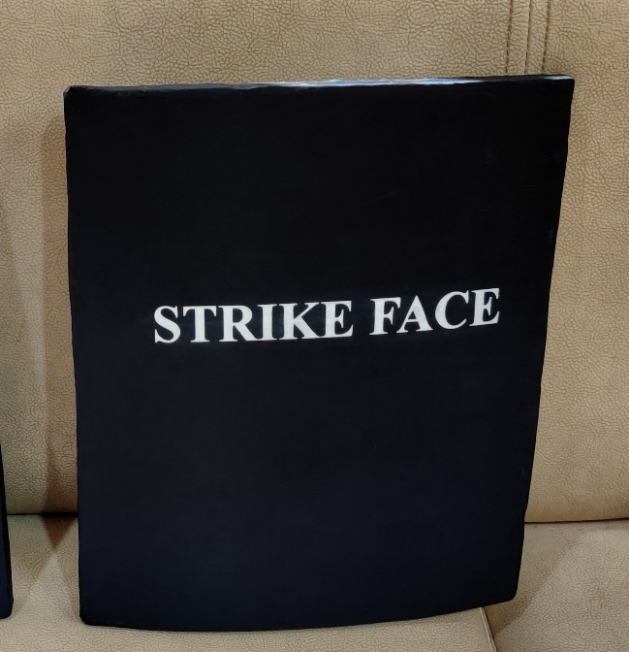
COMMANDO C1 – NIJ LEVEL III
FRONT
REAR
CARRIER
HAP
The bespoke tactical carrier, the COMMANDO C1 achieves the elusive balance between the competing demands of optimum protection and increased mobility through unique ballistic panel contouring. This carrier offers a fully modular tactical armour application where each ballistic panel is removable ensuring complete flexibility for the user, based on ever-changing situational demands. Front, rear and pockets allow to additional protection.
STANDARD PRODUCT FEATURES
Removable & adjustable , dedicated Groin and over-the-shoulder armor panels
Front/rear HAP’s are made from High performance Polyethylene with ultra light weight
Rear waist Band wrap-around drag handle rescue strap (300 lb. capacity)
Integrated Magazine & Granade pouches with flap
Front and Rear VELCRO® ID pads
Easily tuck on Groin panel on front end
Easily adjustable shoulder system for comfort
Water Resistances SAP Pouches with Thermal sealing
Full coverage & adjustable Collar system
Removable Nylon / CORDURA® carrier
NIJ Level III HAP - ICW Soft Armour

Slide 4
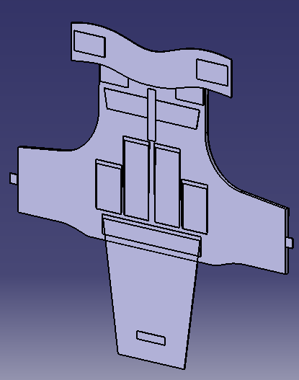
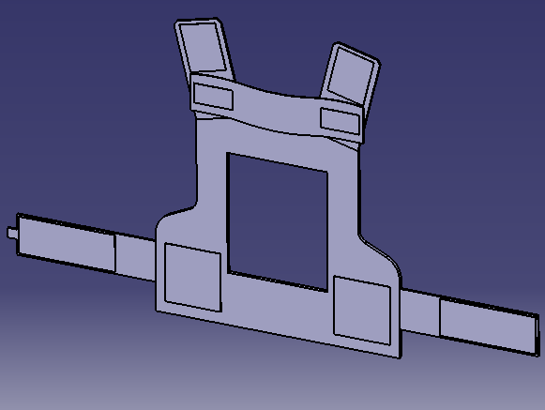
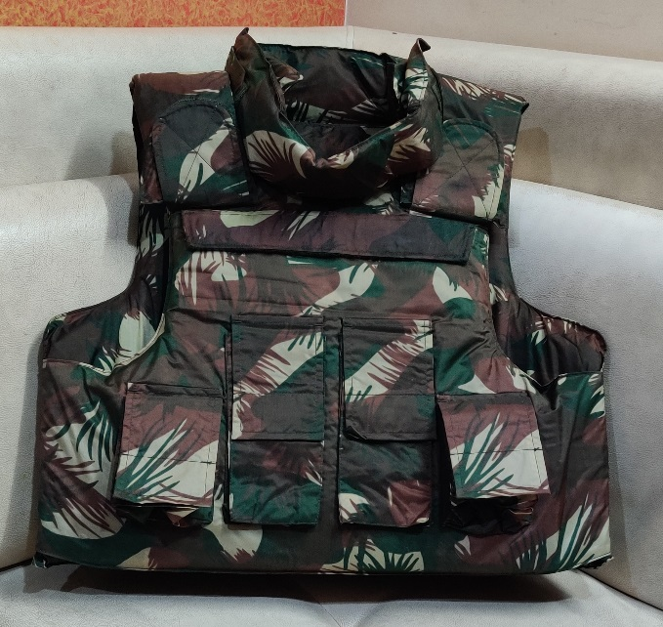
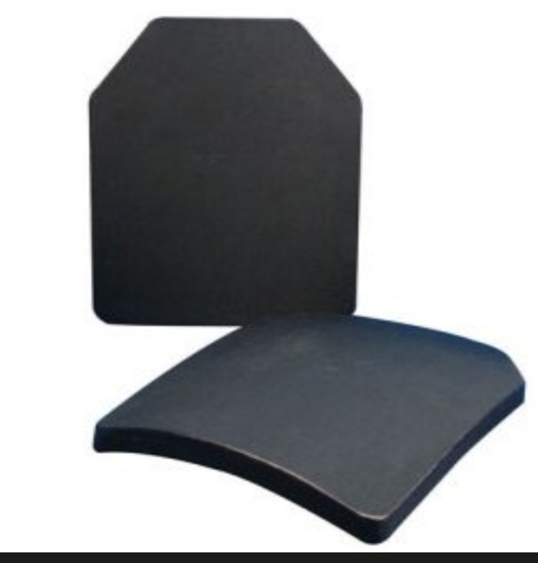
TACTICAL VEST X1 – NIJ LEVEL III+
FRONT
REAR
CARRIER
HAP
The bespoke tactical carrier, the Tactical x1 achieves the elusive balance between the competing demands of optimum protection and increased mobility through unique ballistic panel contouring. This carrier offers a fully modular tactical armor package where each ballistic panel is removable ensuring complete flexibility for the user, based on ever-changing situational demands. Front, rear and pockets allow additional protection.
STANDARD PRODUCT FEATURES
Removable & adjustable , dedicated Groin and over-the-shoulder armor panels
Front/rear internal HAP pockets High Mobility Tactical Cut for ease of operator movement
Rear waist Band wrap-around tummy
Integrated Magazine & Grenade pouches with flap
Front and Rear VELCRO® ID pads
Built-in bar taka all mating parts
Easily adjustable SHOULDER / SIDE STRAP system for comfort
Water Resistances SAP Pouches with Thermal sealing
Full coverage adjustable COLLAR system
Removable Nylon / CORDURA® carrier
NIJ Level III + HAP - ICW Soft Armour

Slide 5
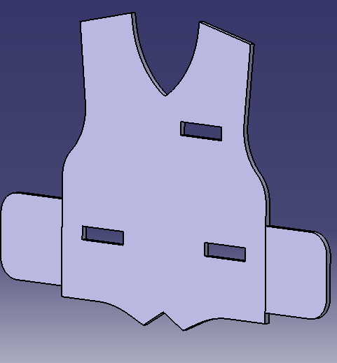
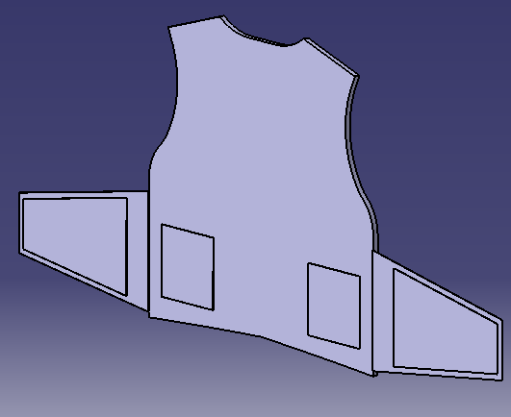
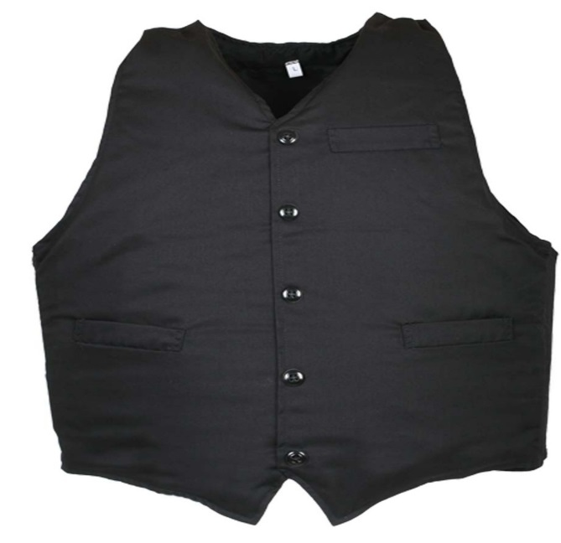
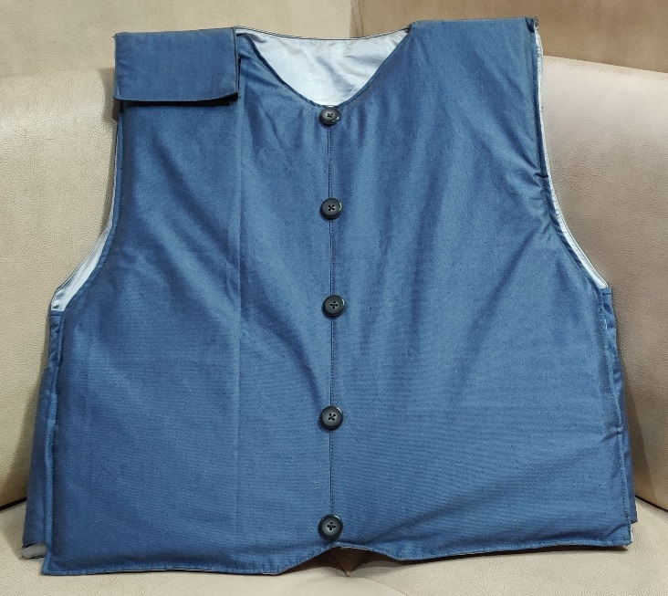
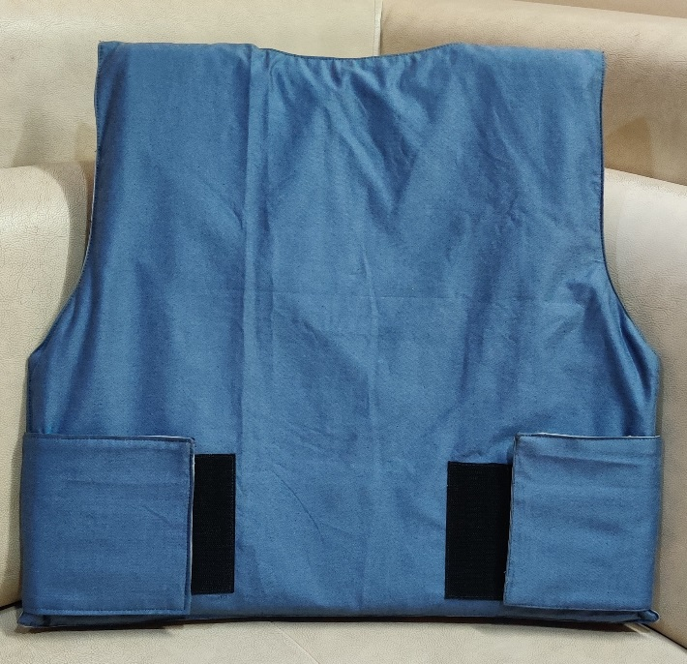
DIMPLOMAT VEST- NIJ LEVEL II / IIIA
FRONT
REAR
STANDARD PRODUCT FEATURES
3 Pcs Blazer Suit design
V / Round Neck styling
Ultra flexible soft armour panels system to wrap body
Side opening style
Velcro Sides straps locking
Padded shoulder
Adjustable sides allow the a custom fit
Water Resistances SAP Pouches with Thermal sealing
Removable Terricot / wool Carrier (with Internal Silky style fabric optional)
Custom Pouches
NIJ Level II / III A

Slide 6
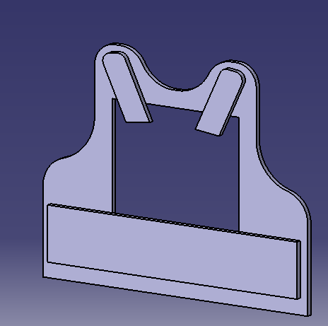
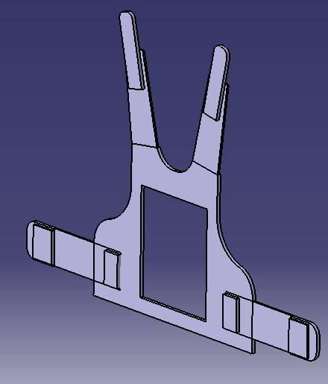
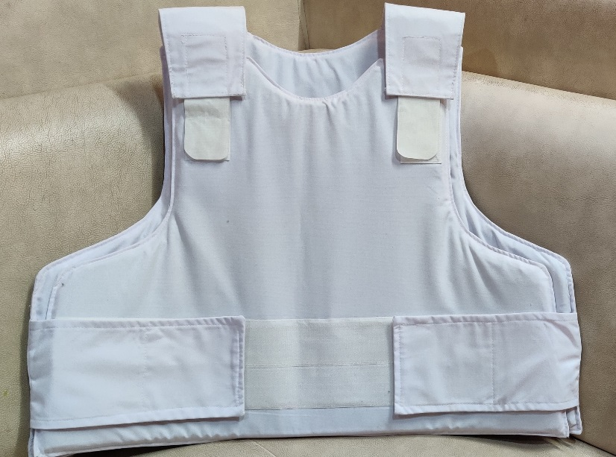
CONCEALABLE VEST- NIJ LEVEL II / IIIA
FRONT
REAR
CONCEPT
Concealable carriers are constructed using a combination of the most flexible advanced materials, which gives maximum comfort for the wearer, add on provision for moisture absorption. When you combine our Outlast proven Technology into your concealable carrier, you have a complete system that makes your vest wearable even in the adverse conditions.
We strive to make the most comfortable, custom-fit vest on the market . Protection against NIJ Level II / IIIA
STANDARD PRODUCT FEATURES
Ultra flexible soft armour panels system to wrap body
Side opening style
Double elastic waist straps
Padded shoulder straps
Adjustable shoulders and sides allow the a custom fit
Built-in bar taka all mating parts
Water Resistances SAP Pouches with Thermal sealing
Removable Poly / Cotton Carrier (with Internal Spacer fabric optional)
Custom Pouches optional
NIJ Level II / III A

Slide 7
BALLISTIC HELMETS

Slide 8
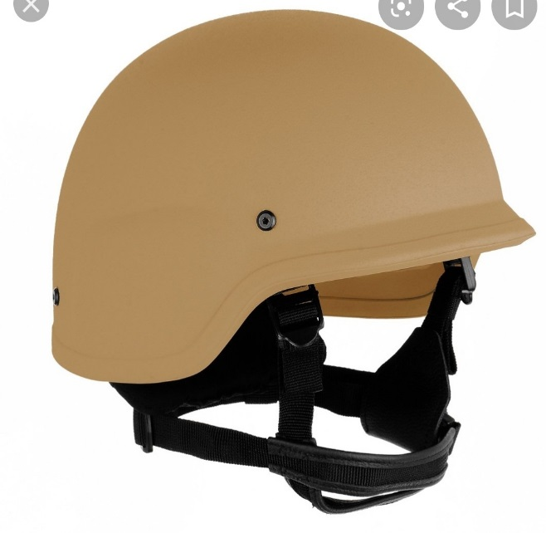
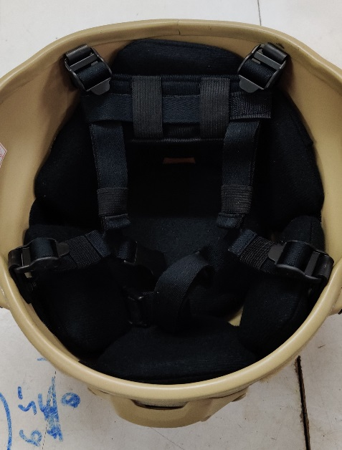
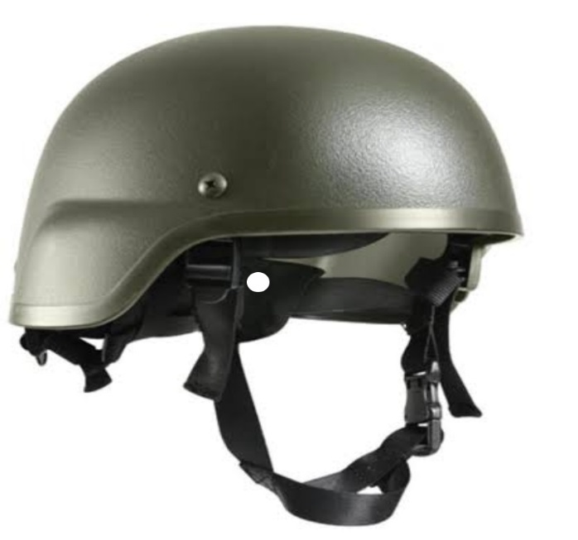
STANDARD FEATURES
Excellent ballistic performance with low weight, design solutions. developed using ballistic aramid Prepress with unique orientation and hot pressing technique in High Tonnage Compression moulding method and perfect fit suspension system.
Suspension Systems
Custom built Harnessing system
3 or 4 Point suspension systems. All have a 4 point chin strap harness, with an integrated nape pad
Crown Mesh with cross straps; with plastic chin cup / web holding..
Leather Ring: Shock Absorption harness, with leather webbing and leather split chin strap.
Pad: 7 EVA / XLMPE foam pads; with webbing split chin strap
Weight range: 1.150kg - 1.5 kg
Protection : NIJ Level II & IIIA
Colours: Olive Green, Desert Tan, Black
BALLISTIC HELMET NIJ LEVEL II / III A
PASGT
MICH
PASGT Helmets (US Personal Armor System Ground Troops) Helmet provides protect against fragments/ sharp objects and other ballistic threats; with desired comfort. Used by, Special Forces, Para, Police, Military and SWAT Personnel.
Size : Medium & Large
MICH Helmet (Modular Integrated Communications Helmet). It is a concept of lighter and more compact version of the PASGT helmet; with reduced ear coverage, no lip at front and reduced coverage at the back. This allows for good clarity vision and hearing and also support the wearer to shoot from the prone position
Size : Medium & Large

